Slide 1
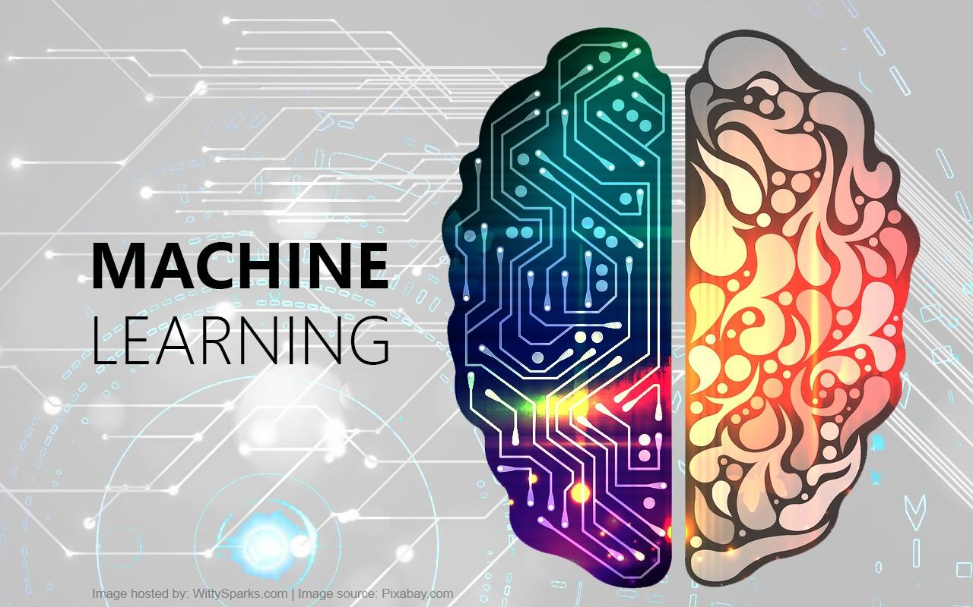
Prepared By: Prof. Vandana Kate

Slide 2
WHAT IS MACHINE LEARNING?
Machine learning (ML) is a category of an algorithm that allows software applications to become more accurate in predicting outcomes without being explicitly programmed
Machine learning is a way of identifying patterns in data and using them to automatically make predictions or decisions.

Slide 3
REASON FOR RISE OF MACHINE LEARNING?
The high amount of data production by applications
The increase of computation power in the past
few years
The development of better algorithms

Slide 4
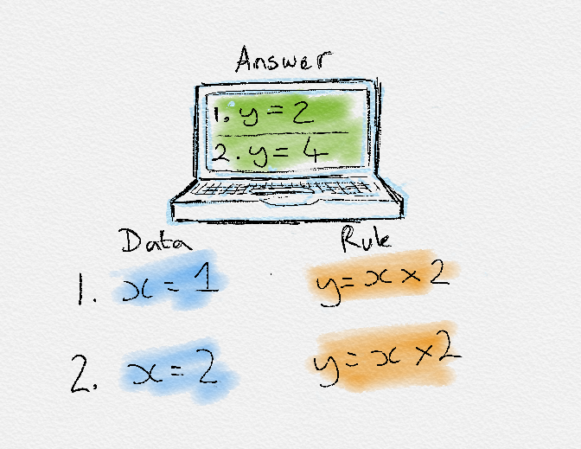
RULE BASED LEARNING

Slide 5
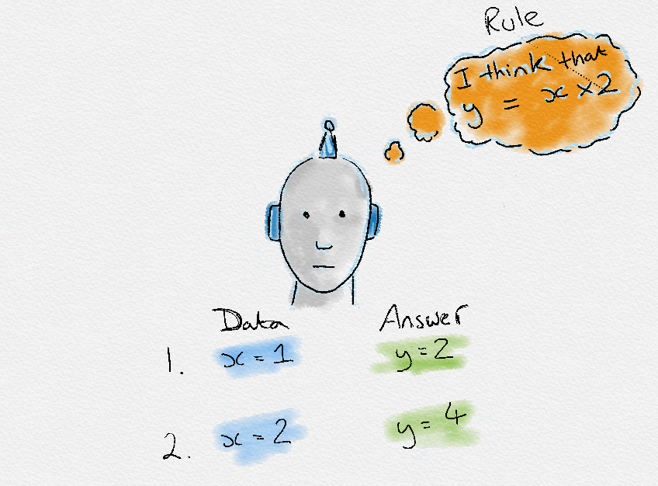
HOW MACHINE LEARNS ?

Slide 6
EXAMPLES OF ML IN USE.
Prediction
Image recognition
Speech Recognition
Medical diagnoses
Financial industry

Slide 7
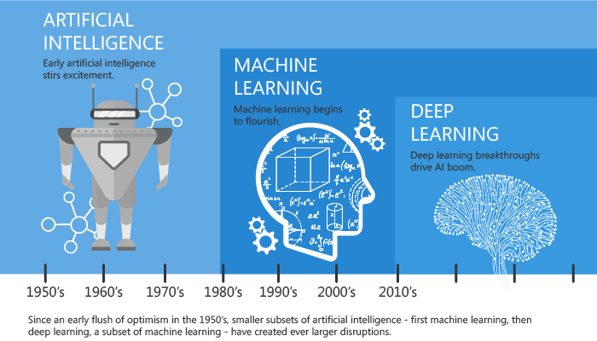
A QUICK HISTORY OF MACHINE LEARNING

Slide 8
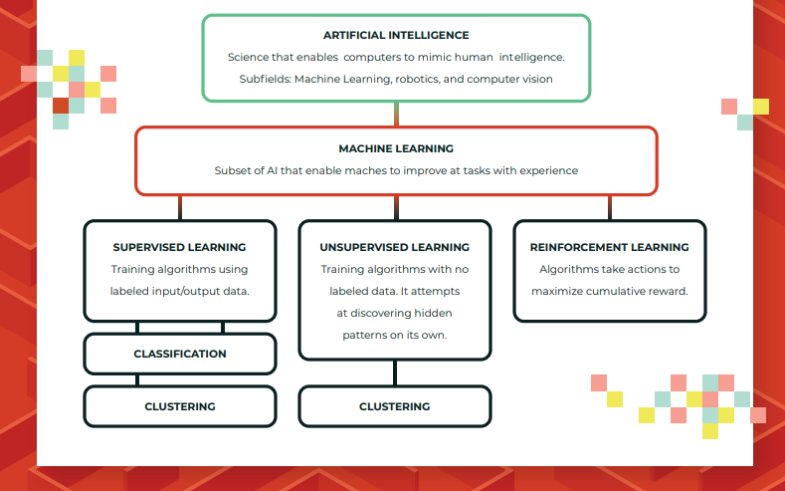

Slide 9
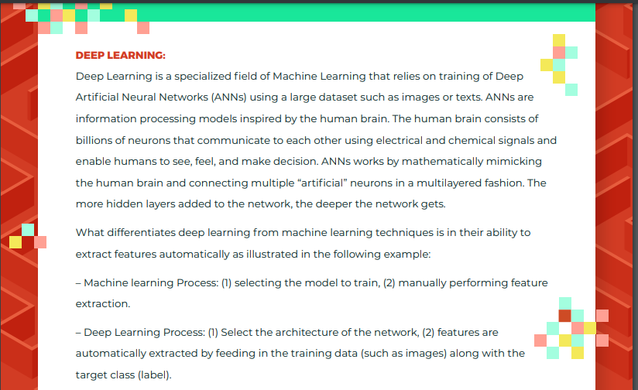

Slide 10
TYPES OF MACHINE LEARNING?
Machine learning can be classified into 3 types of algorithms.
Supervised Learning
Unsupervised Learning
Reinforcement Learning

Slide 11

SUPERVISED LEARNING
the goal is to learn the mapping (the rules) between a set of inputs and outputs.

Slide 12
TYPES OF SUPERVISED LEARNING
Classification: A classification problem is when the output variable is a category, such as “red” or “blue” or “disease” and “no disease”
Regression: A regression problem is when the output variable is a real value, such as “dollars” or “weight”.

Slide 13
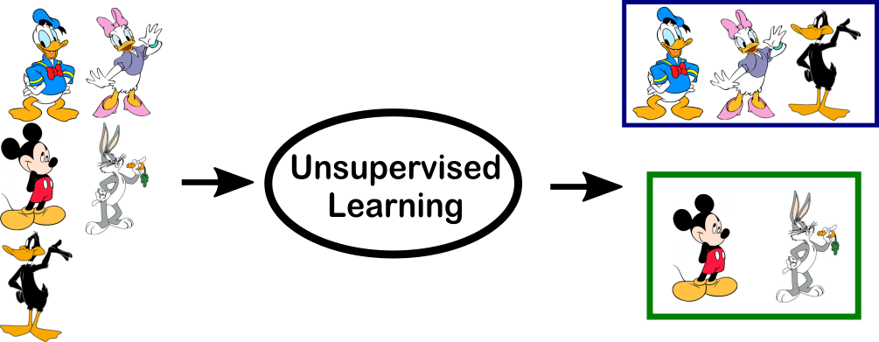
UNSUPERVISED LEARNING ALGORITHM

Slide 14
TYPES OF UNSUPERVISED LEARNING
Clustering: A clustering problem is where you want to discover the inherent groupings in the data, such as grouping customers by purchasing behavior
Association: An association rule learning problem is where you want to discover rules that describe large portions of your data, such as people that buy X also tend to buy Y

Slide 15
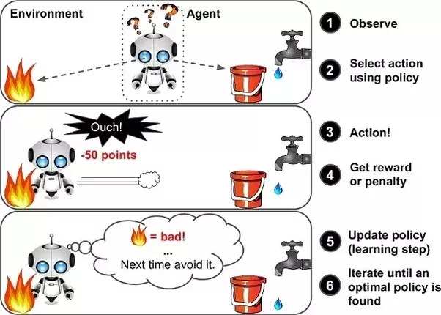
REINFORCEMENT LEARNING
In this approach, occasional positive and negative feedback is used to reinforce behaviors

Slide 16
ML APPLICATIONS
Enhanced Unsupervised Algorithm
Highly Personalization
Collaborative Learning/Edge Analytics
Quantum Computing
Cognitive services

Slide 17
WHAT YOU'LL LEARN
Fundamental concepts of machine learning
Linear regression, correlation, and the phenomenon of regression to the mean
Classification using the k-nearest neighbors algorithm
How to compare and evaluate the accuracy of machine learning models
Basic probability and Bayes’ theorem

Slide 18
PYTHON THE BEST-SUITED PROGRAMMING LANGUAGE FOR MACHINE LEARNING?
Python is Easy To Use: is simple with an easily readable syntax and that makes it well-loved by both seasoned developers and experimental students
Python has multiple Libraries and Frameworks:
Keras is an open-source library that is particularly focused on experimentation with deep neural networks.
TensorFlow is a free software library that is used for many machine learning applications like neural networks. (They seem to be quite popular!)
Scikit-learn is a free software library for Machine Learning that various classification, regression and clustering algorithms related to this. Also, Scikit-learn can be used in conjugation with NumPy and SciPy.

Slide 19
PYTHON THE BEST-SUITED PROGRAMMING LANGUAGE FOR MACHINE LEARNING?
Python has Community and Corporate Support
Python is Portable and Extensible

Slide 20
QUERIES?

